Slide 1
Salary Predictions Project Summary
Tiago Fernandes Lins

Slide 2
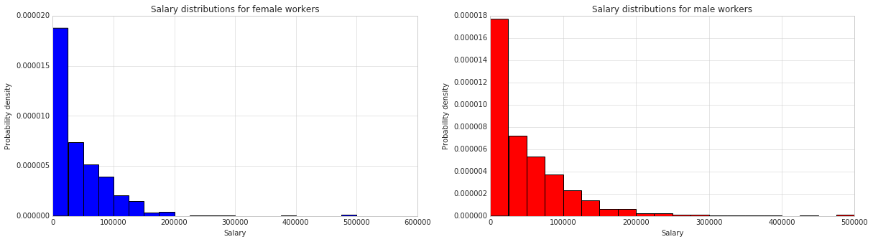
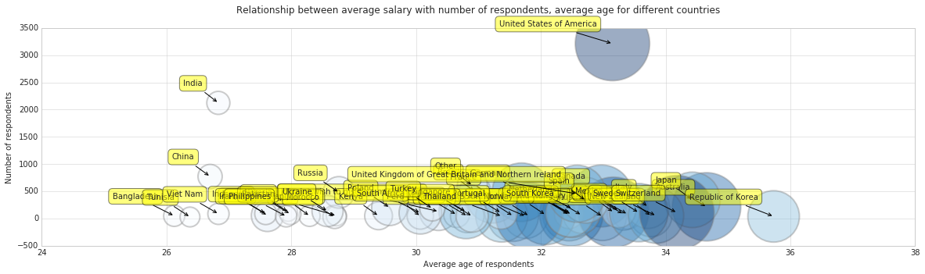
Data Visualization
Salary distribution among males and females appear similar, but there tends to be more high outliers for males
Data points from United states and India appear to have a more observable effect on salary

Slide 3
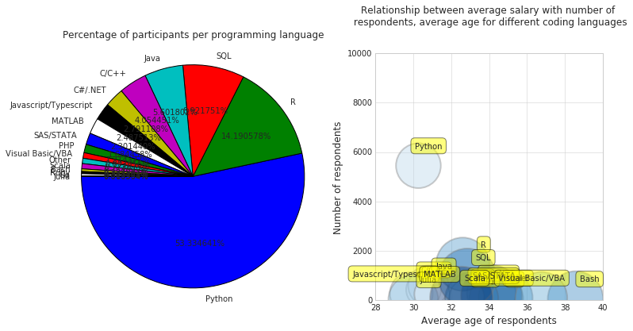
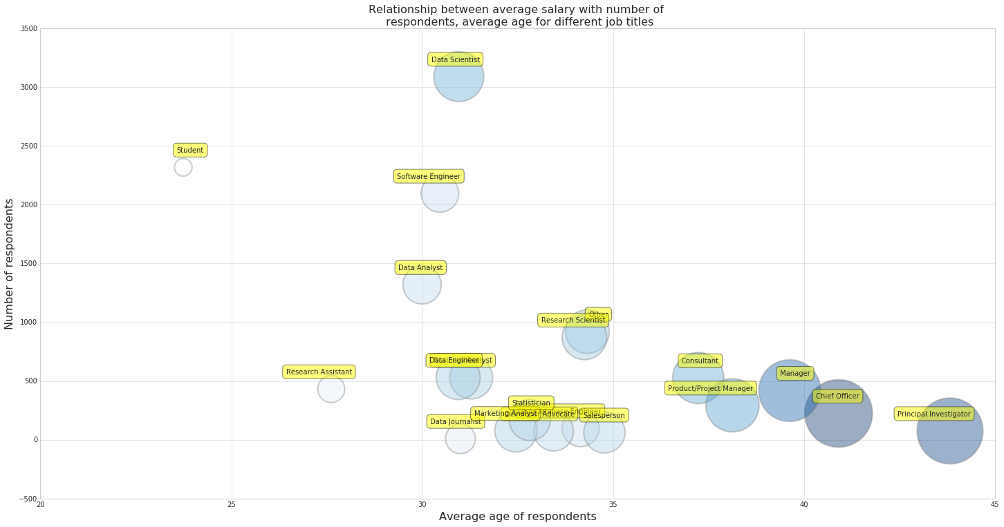
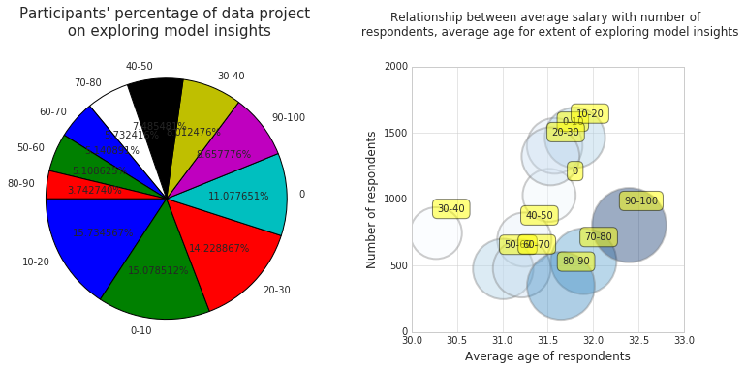
Data visualization
Interesting trends for tools, techniques and experience for data scientists
Python most commonly used, but no obvious relationship with salary
High percentage of time exploring model insights related to higher median salary
Different career pathways based on age and experience

Slide 4
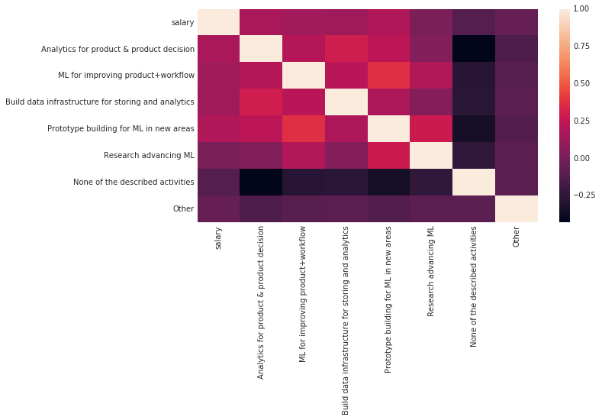
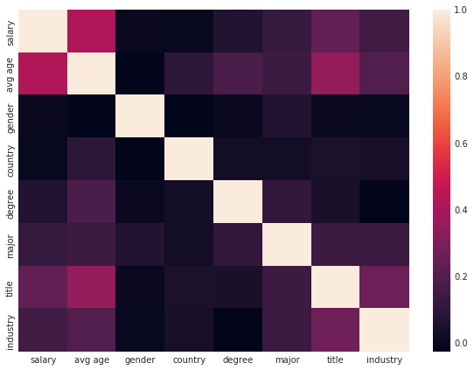
Feature Importance
Evaluated through multiple tests: correlation plots,
F-test with salary data, LASSO and decision trees
Feature importance | Features
16076.78 | country_United States of America
6913.296 | avg age
6706.105 | role_experience
5460.469 | title_Chief Officer
4236.274 | ML_incorporation
3412.384 | country_Switzerland
3308.995 | ML_years
3024.864 | title_Manager
3001.495 | industry_Accounting/Finance
2917.384 | country_Australia
Top 10 feature by LASSO with their respective regression coefficient

Slide 5
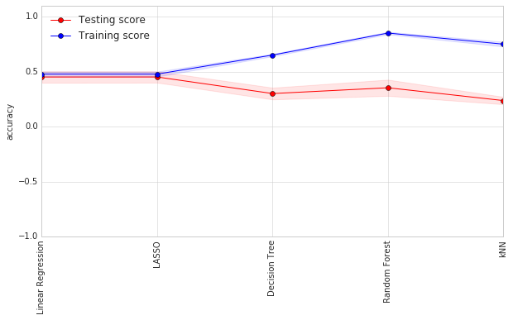
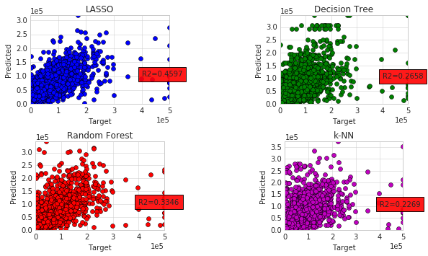

Training regression algorithms
Univariate feature selection combined with feature engineering $(x_{1}x_{2}, x_{1}x_{3}, …,x_{n−1}x_{n})$ are included and used for training

Slide 6
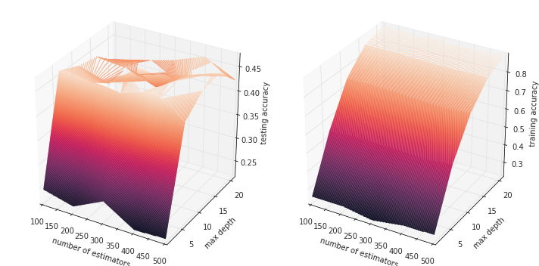
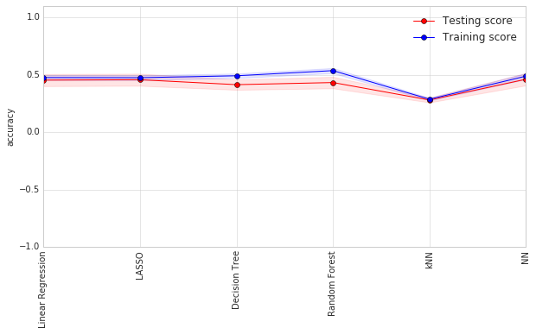

Training regression algorithms
Hyperparameter tuning
Slight reduction of overfit, $R^{2}$ still low generally
K-NN showed lowest score overall, Random Forest showed highest training score
Optimized neural network
Input features
35
35
30
Output
Hidden layers

